Slide 2
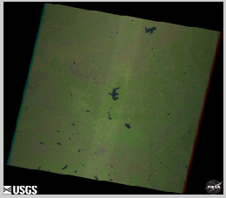
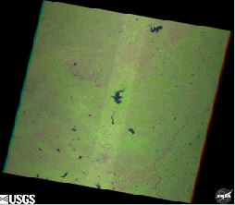
MODULE-1 EXECUTION
ORIGINAL IMAGE
AFTER PREPROCESSING

Slide 3
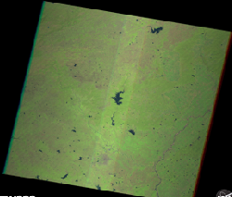
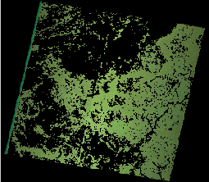
MODULE-2 EXECUTION
FUSED IMAGE
SEGMENTED IMAGE

Slide 4
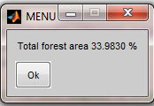
MODULE-2 EXECUTION

Slide 5
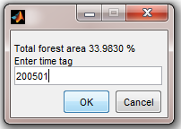
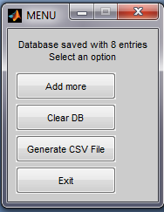
MODULE-3 EXECUTION

Slide 6
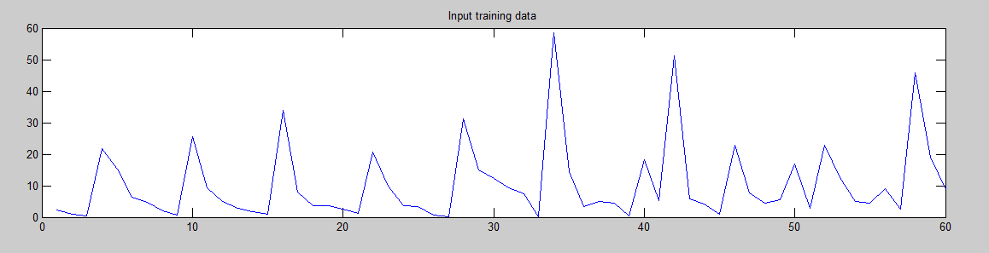
MODULE-4 EXECUTION
Training data for Pench(2005 to 2014)

Slide 7
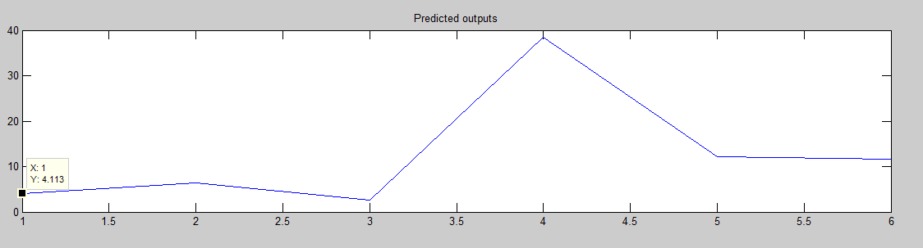
MODULE-4 EXECUTION
Output Prediction for 2015
JANUARY 2015:

Slide 8
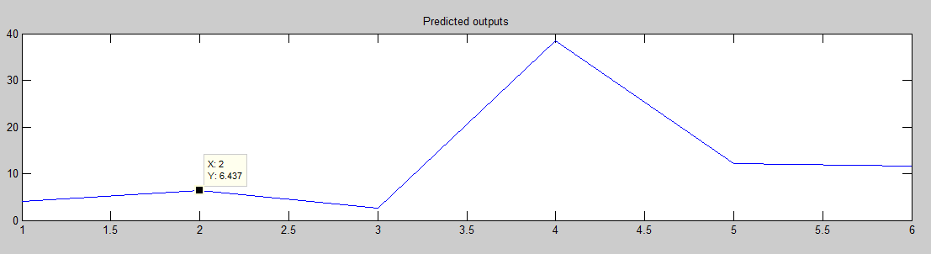
MODULE-4 EXECUTION
FEBRUARY 2015:

Slide 9
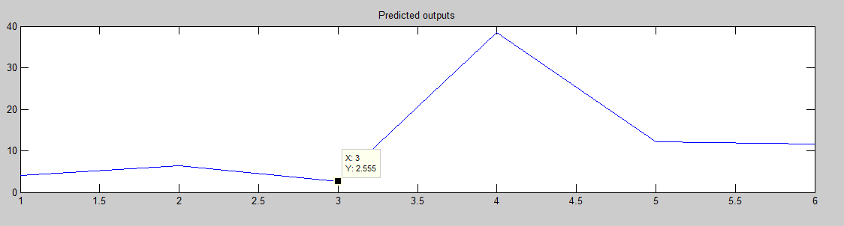
MODULE-4 EXECUTION
MARCH 2015:

Slide 10
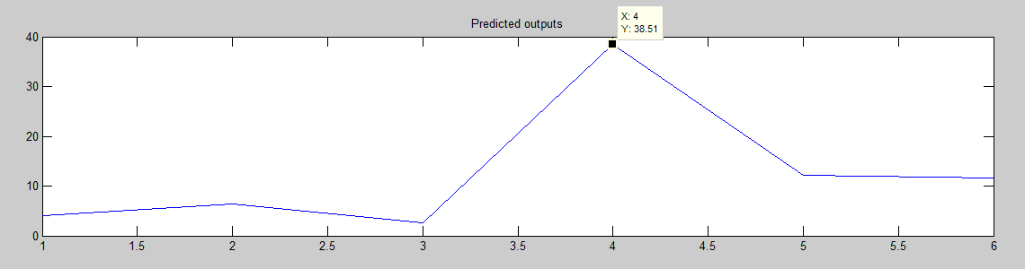
MODULE-4 EXECUTION
OCTOBER 2015:

Slide 11
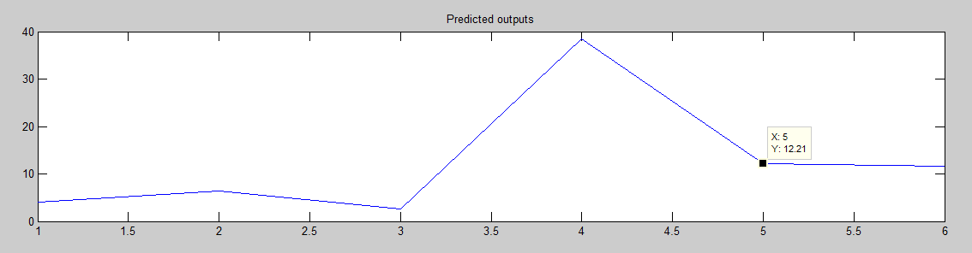
MODULE-4 EXECUTION
NOVEMBER 2015

Slide 12
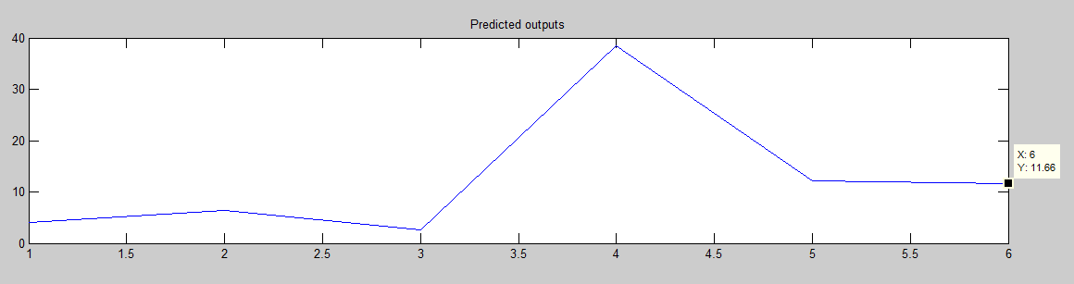
MODULE-4 EXECUTION
DECEMBER 2015

